Slide 1
Cold war: The berlin wall
Aug. 1961 – Nov. 9, 1989

Slide 2
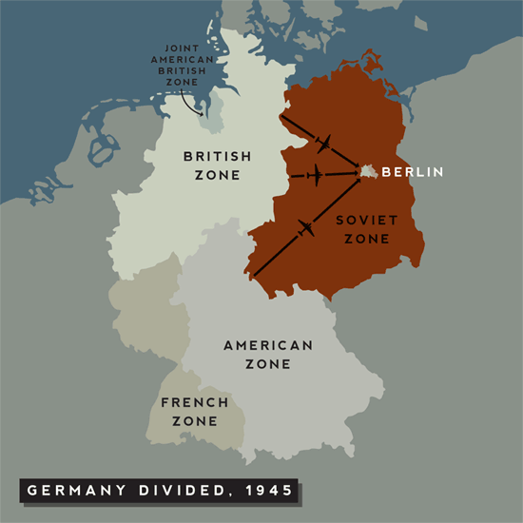
Image Source: http://historycoldwarera.webnode.com/main-events/berlin-blockade/

Slide 3
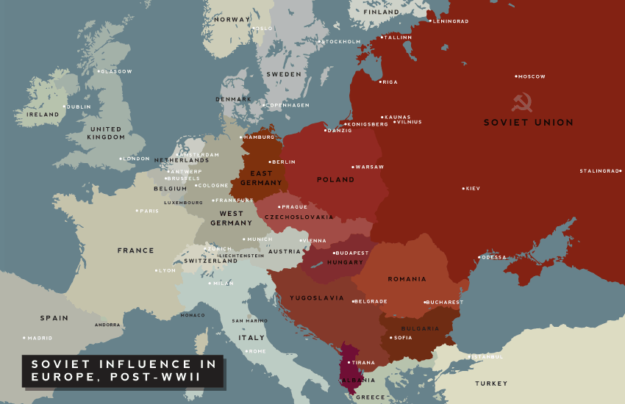

Slide 4
History Channel Berlin Wall Video

Slide 5
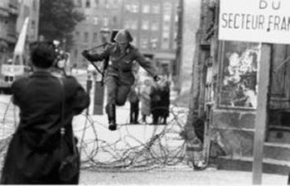
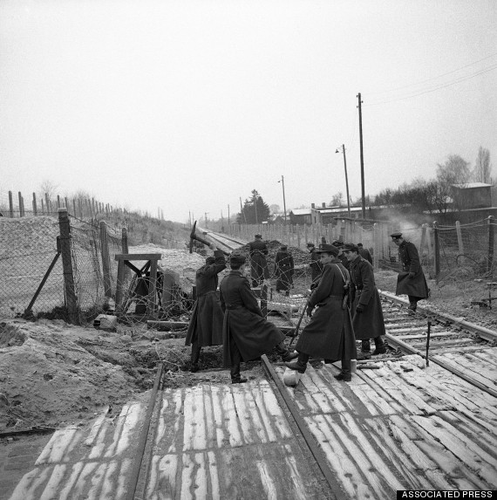
10 Greatest Escapes http://www.gettyimages.com/detail/video/crossing-the-berlin-wall-cemetery-with-dogs-and-barbed-news-footage/142653776 Schumann article http://www.independent.co.uk/arts-entertainment/the-leap-of-hope-that-ended-in-despair-1167101.html
Conrad Schumann – East German NCO leaping to freedom
East German police use picks and shovels to tear up railroad tracks used by Harry Deterling to drive a train into West Berlin on Dec. 5, 1961. Source: http://www.huffingtonpost.com/2014/11/07/berlin-wall-escape-stories_n_6090602.html

