Slide 1
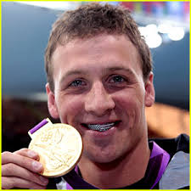
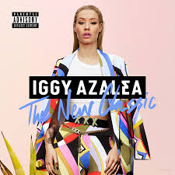
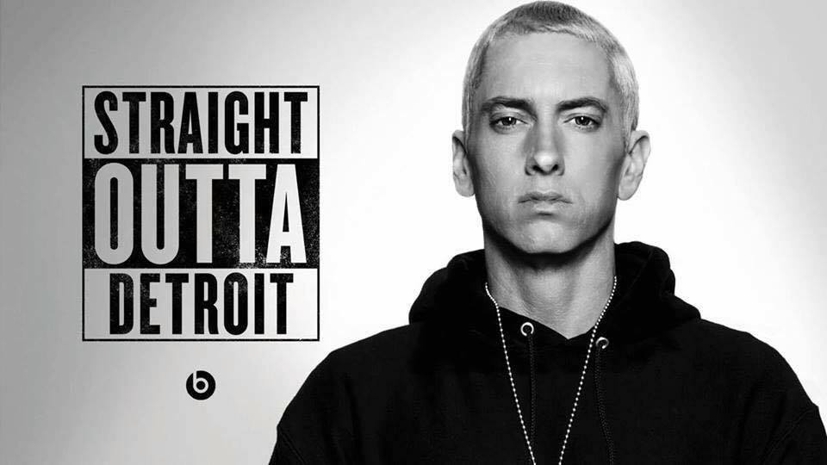
Starter #1-3: Write a journal response to following questions. You may consider the questions as a whole or focus your answer on a single question. Make sure to support your opinion.
Is it OK for white people to wear their hair in dreadlocks, corn rows, or Afros (traditionally African/African American styles)?
Is it OK for non-Hindus to wear a Bindi (a decoration in the middle of the forehead that is part of the Hindu religion).
Is it OK for white singers to make/sell/perform rap music?

Slide 2
Cultural appropriation

Slide 3
What is cultural appropriation?
The process by which cultures adopt customs and knowledge from other cultures and use them for their own benefit
Often viewed as exploitation

Slide 4
Ethnocentric:
Viewing one’s culture as superior to others
evaluating other peoples and cultures according to the standards of one's own culture
Eurocentric – regarding European/white/western culture as preeminent
Afrocentric – regarding African or black culture as preeminent

Slide 5
Amandla Stenberg: Don't Cash Crop On My Cornrows
Kat Blaque - True Tea
Fashion & Cultural Appropriation

Slide 6
How Iggy Azalea Mastered Her "Blaccent"

Slide 7
http://www.bbc.com/news/uk-36279845
http://www.diversityinc.com/news/hairstyles-of-black-women-cases-of-discrimination/
http://www.ebony.com/style/fighting-for-our-hair-in-corporate-america-032#axzz4W9Bd78TX
https://twitter.com/BonKamona/status/717457819864272896/photo/1?ref_src=twsrc%5Etfw
http://www.takepart.com/article/2016/04/13/what-perception-professional-hair-means-black-job-seekers

