Slide 1
Shapes of states review

Slide 2
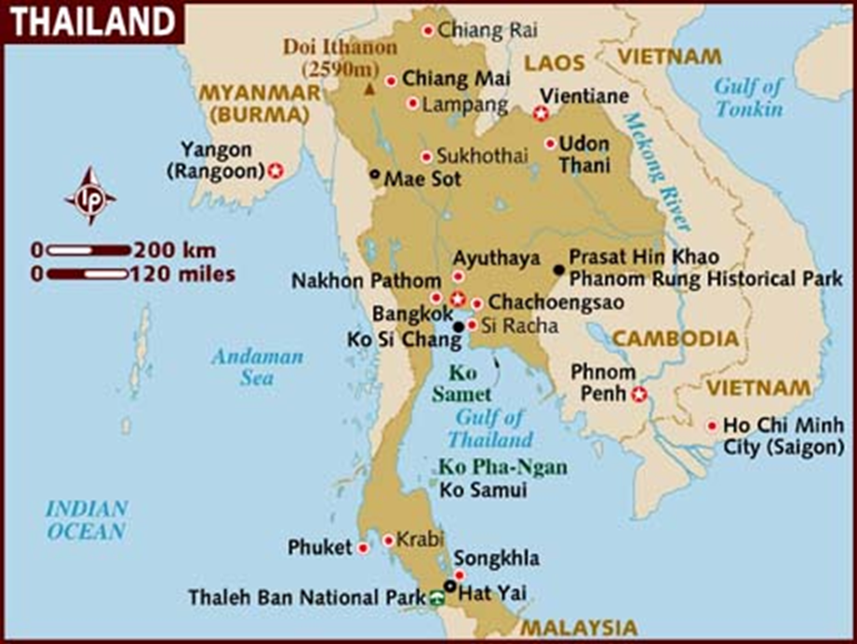
Thailand
Prorupted state

Slide 3
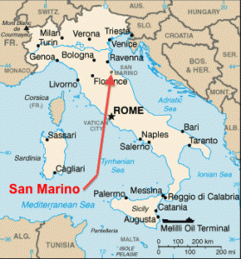
San Marino
Landlocked state
Compact state
http://maplists.com/wp-content/uploads/map-of-europe-san-marino-37558575.jpg

Slide 4
Italy
Perforated state
Elongated state
http://maplists.com/wp-content/uploads/map-of-europe-san-marino-37558575.jpg

Slide 5
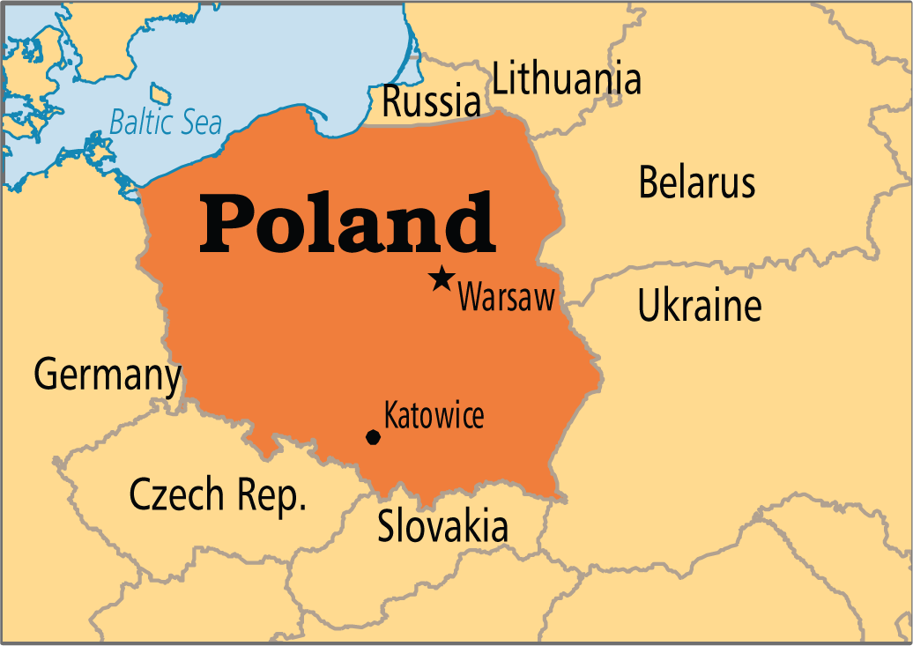
Poland
Compact state
http://www.operationworld.org/country/pola/owtext.html

Slide 6
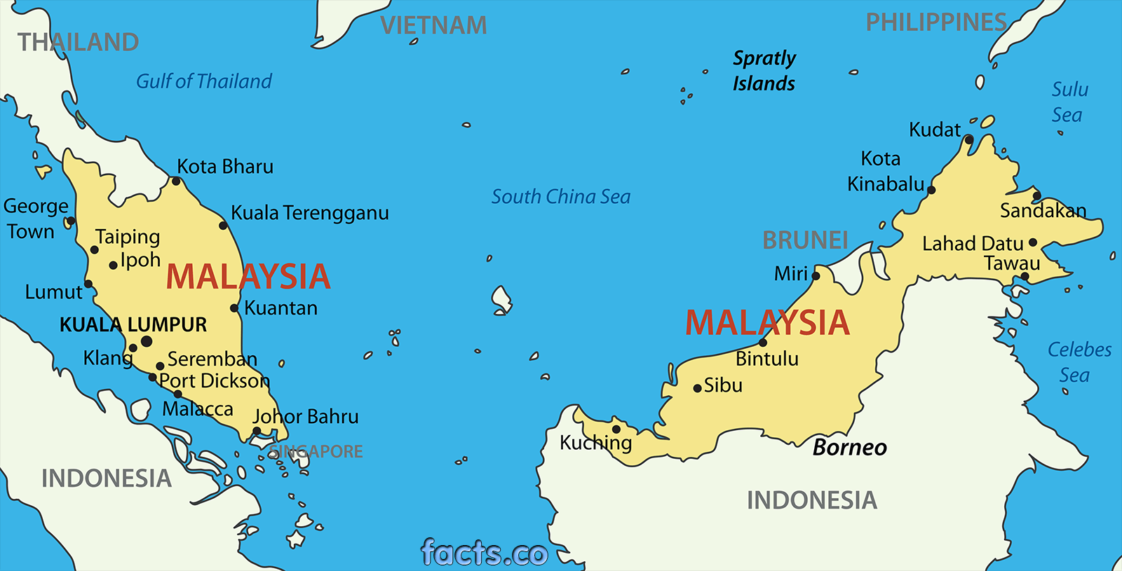
Malaysia
Fragmented state
http://malaysiamap.facts.co/malaysiamapof/malaysiamap.php

Slide 7
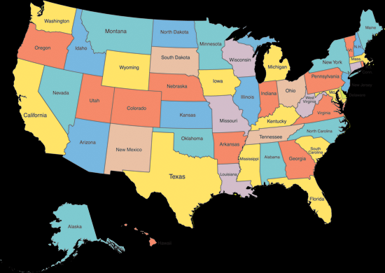
United States
Fragmented state
http://www.bing.com/images/search%5C?q=usa+map&view=detail&first=0

Slide 8
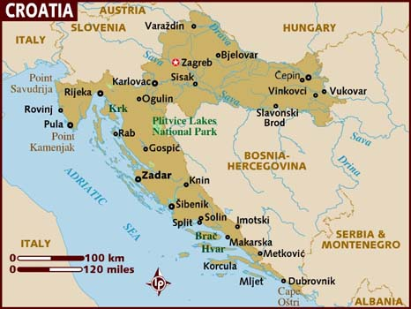
Croatia
Elongated state
http://www.lonelyplanet.com/maps/europe/croatia/

Slide 9
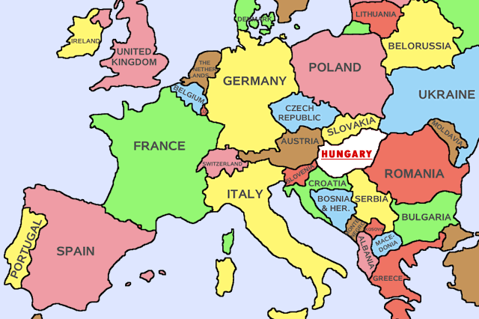
Hungary
Landlocked state
Compact state
http://mapssite.blogspot.com/2009/09/map-of-europe-hungary.html

Slide 10
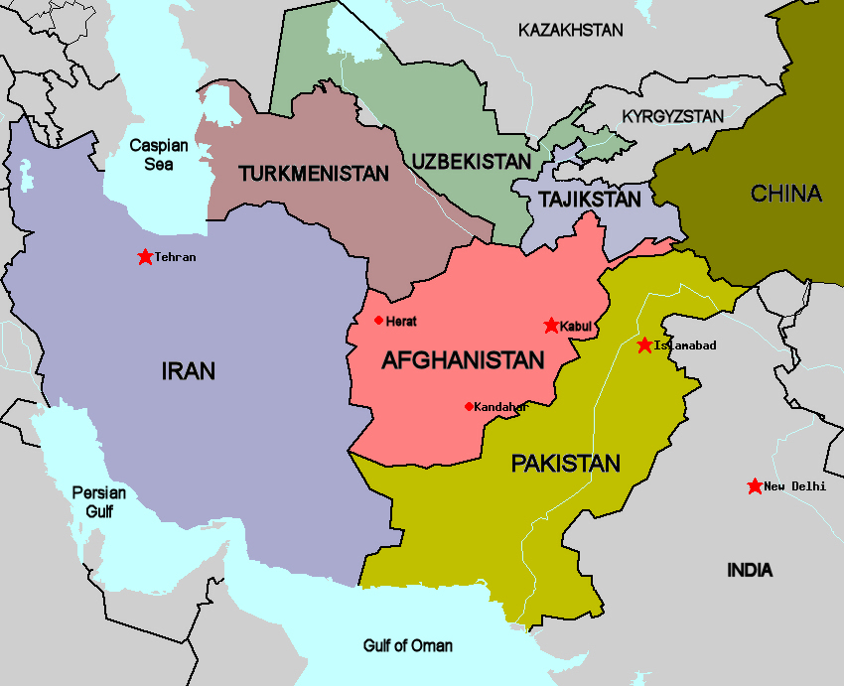
Afghanistan
Landlocked state
Prorupted state
http://sites.stedwards.edu/craigc-crij4347asp2015/middle-eastnorth-africa/taliban/

Slide 11
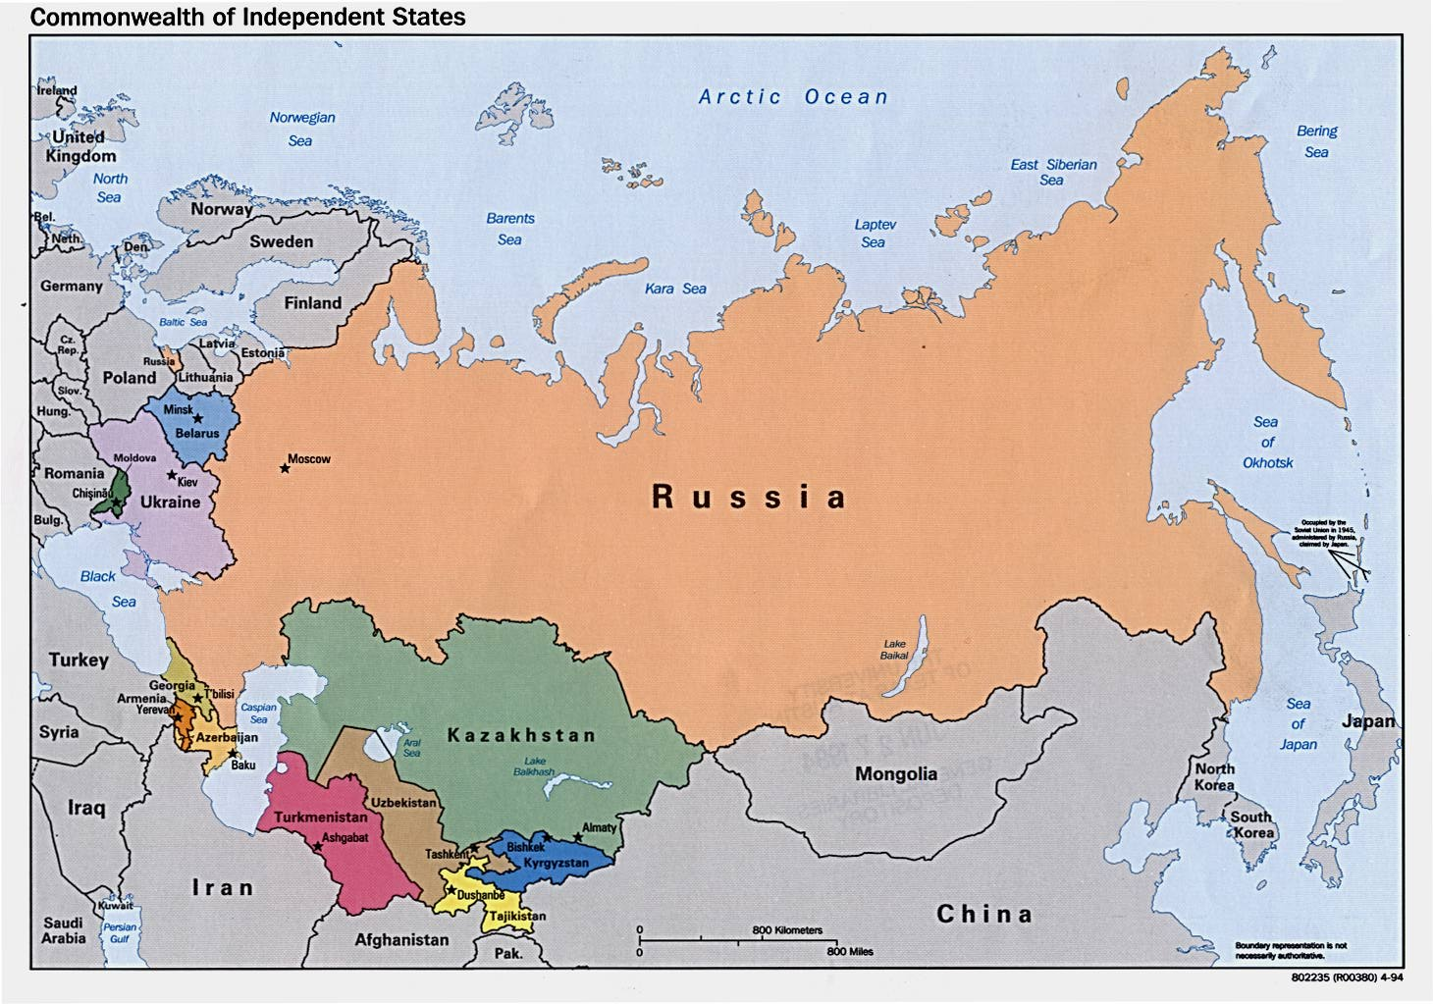
Russia
Fragmented state
http://www.lib.utexas.edu/maps/commonwealth.html

Slide 12
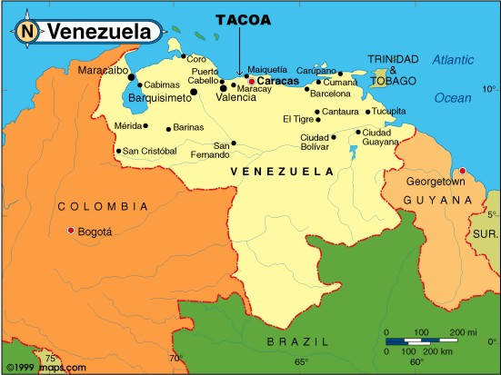
Venezuela
Compact state
http://travelquaz.com/map-of-venezuela.html/map-of-venezuela-map-of-world-map-of-europe-map-of-asia-map

Slide 13
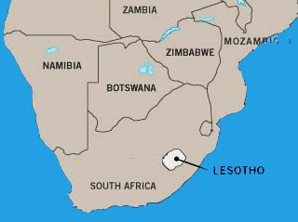
South Africa & Lesotho
Which is the perforated state?
http://www.traveltales.ca/www/AFRICA/08%20Lesotho/lesotho.htm

